Slide 1
Output to Raspberry Pi
ARDUINO UNO R3
GAS SENSOR
SENSOR BOARD
(for Thermal + Wind sensors)
3.3V
D19/SCL
SCL
3.3V
WIND SENSOR
5V
D18/SDA
SDA
GND
Common
5V
5V
Speed
GND
GND
GND
Direction
Legend:
D2
Voltage line
THERMAL SENSOR
Ground line
A0
5V
SDA
SCL/ Wind dir. line
Common GND
A4 (D18)
SDA/ Wind spd. line
GND
SCL
A5 (D19)
Res pull up/down line

Slide 2
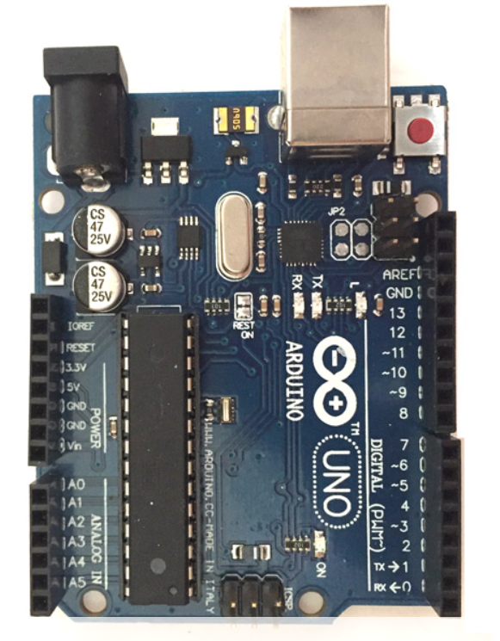
Connection to
Raspberry Pi 3B
A4, A5: Another analog SDA/SCL pins for Thermal sensor data (for Option #2)
Ground and Vdc pins:
+5 Vdc: 1 pin
+3.3 Vdc: 1 pin
GND: 2 pins
A0: Analog pin for Wind sensor’s wind direction data
D2: Digital Interrupt pin for Wind sensor’s wind speed data
A4, A5: Analog SDA/SCL pins for SO2
Gas sensor’s data
PIN ASSIGNMENT FOR CONNECTING SENSOR THROUGH ARDUINO

Slide 3
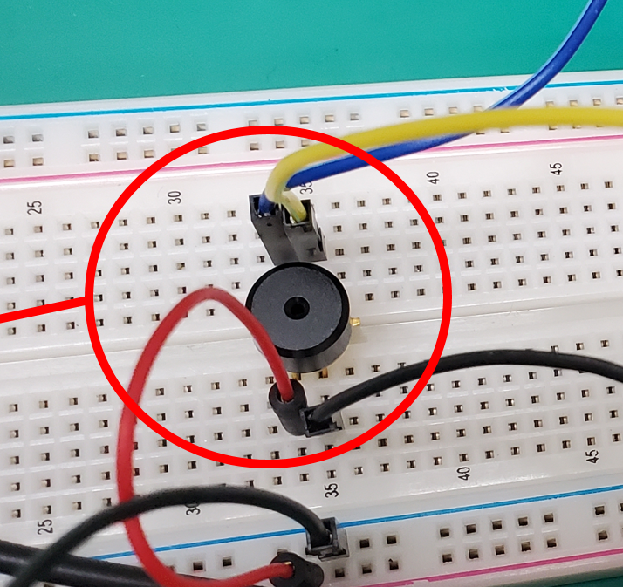
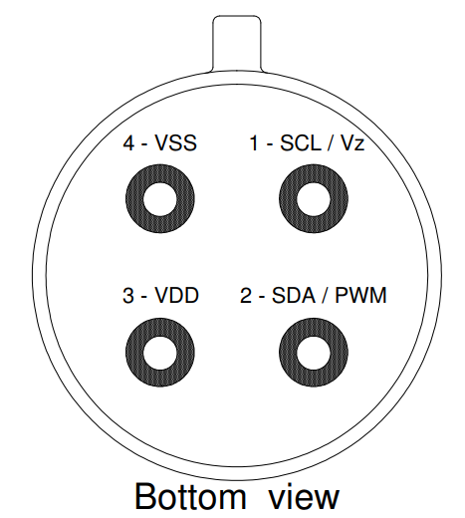
THERMAL SENSOR
WIND SENSOR

